Slide 1
Section 1.7: Coloring Graphs
Math for Liberal Studies

Slide 2
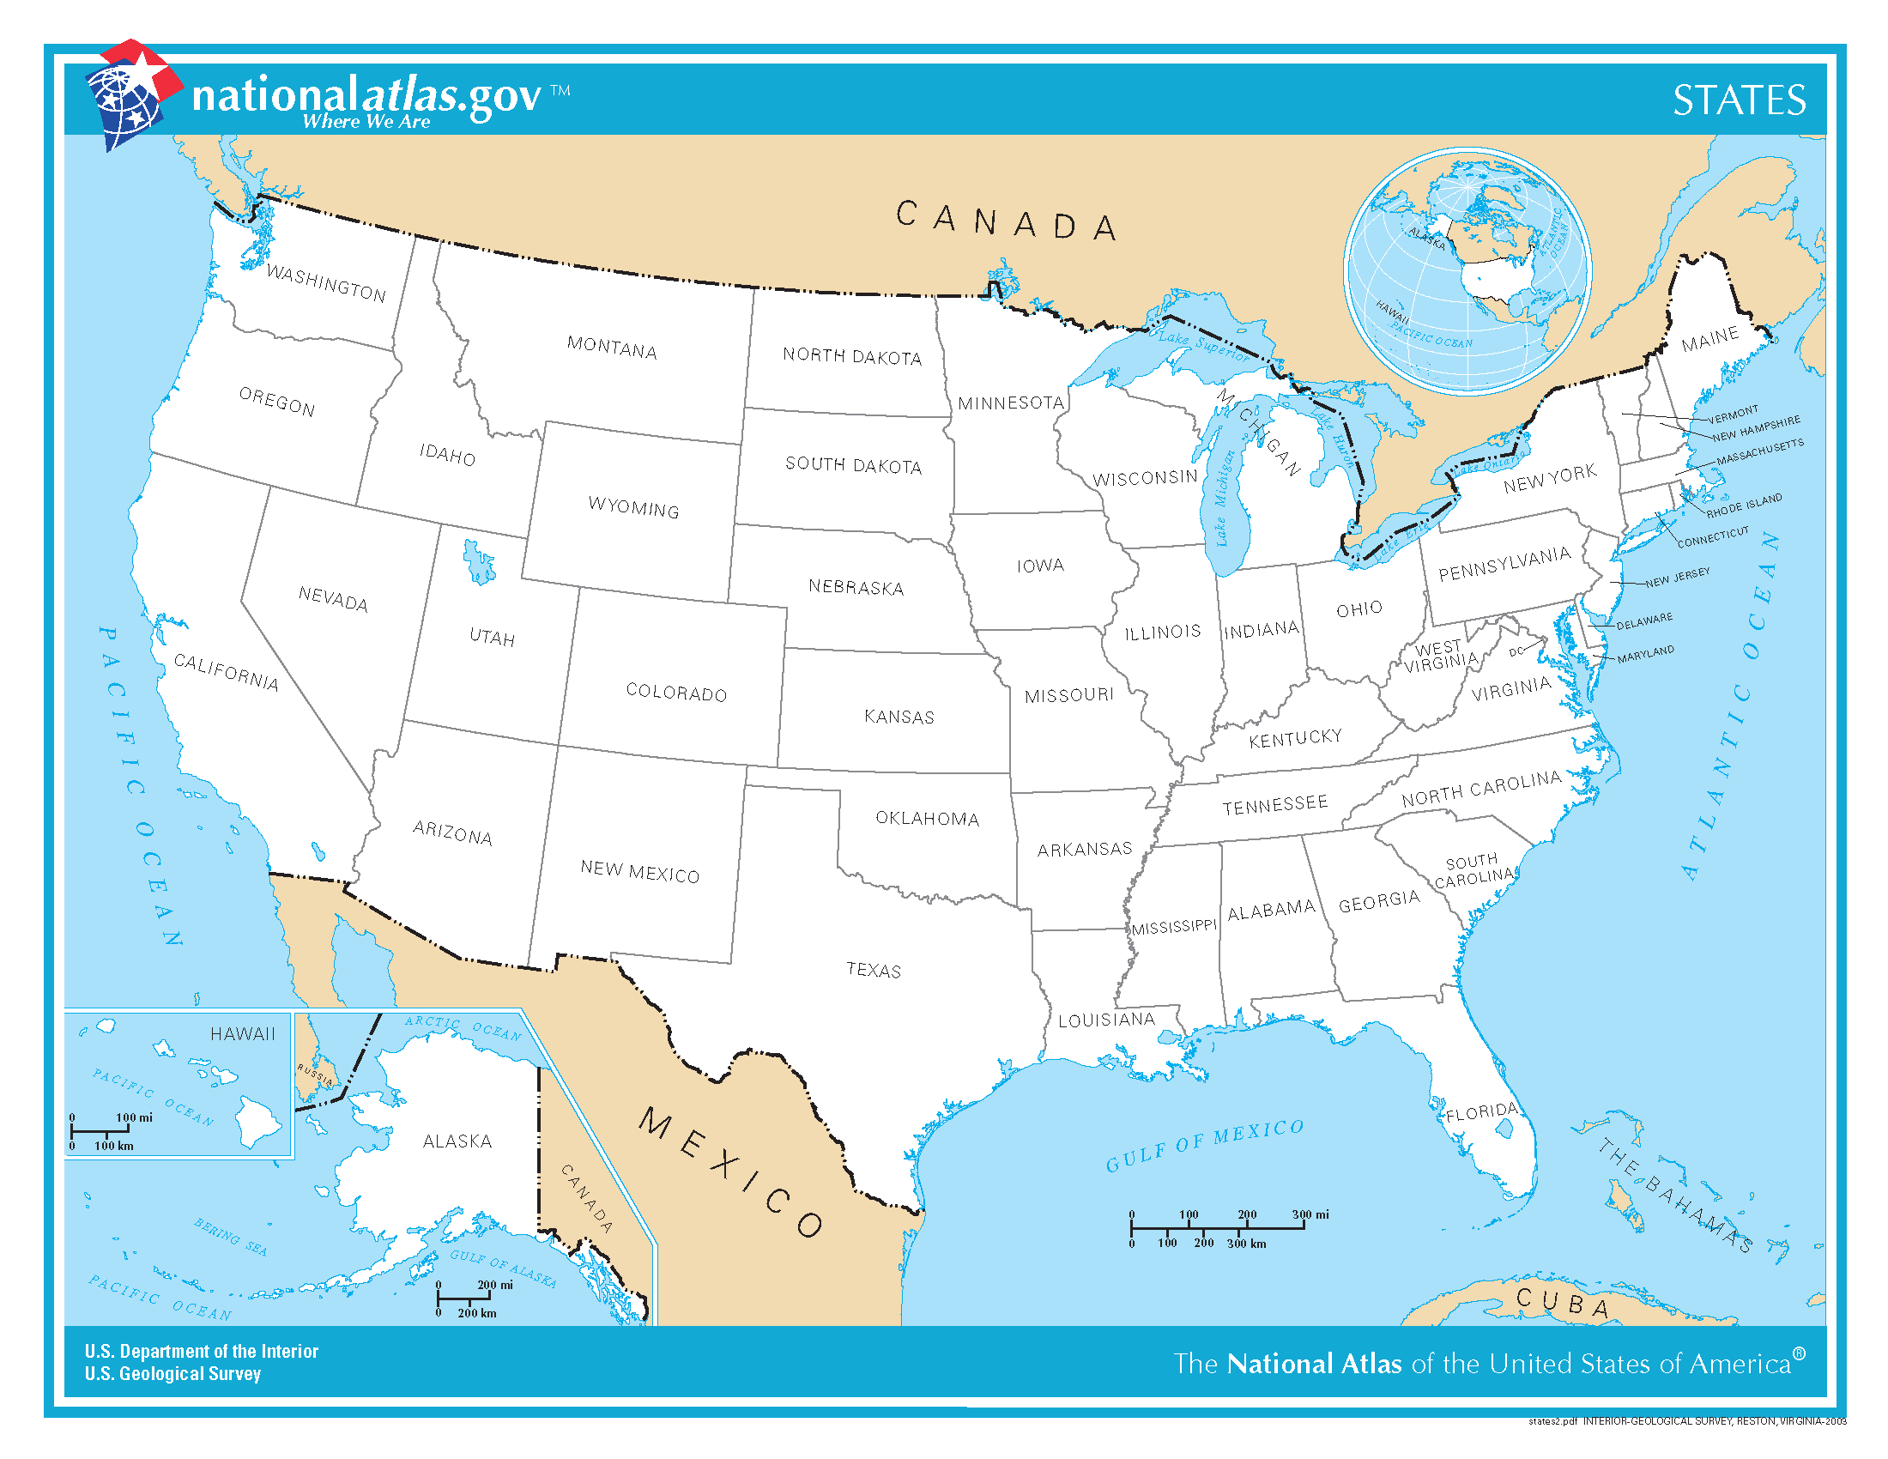
Maps and Colors
Take a look at this map of the US

Slide 3
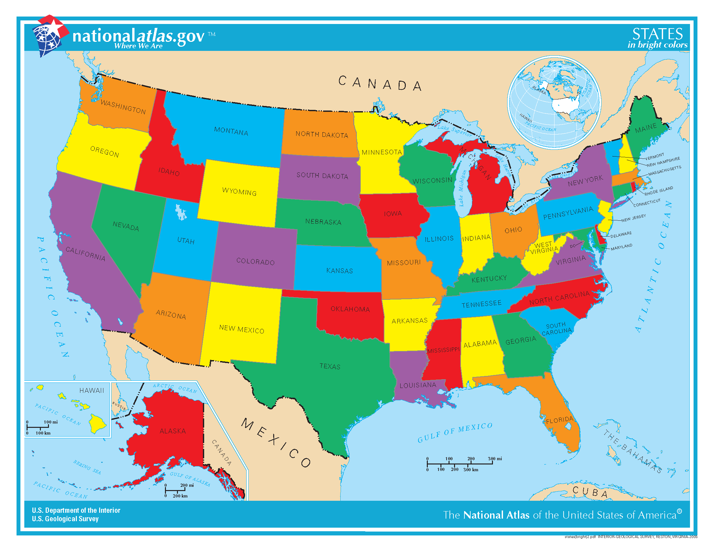
Maps and Colors
We can color in the states like this

Slide 4
Maps and Colors
This is a “proper” coloring because no two bordering states are the same color

Slide 5
Maps and Colors
This coloring uses 6 colors; is it possible to color the map with fewer colors?

Slide 6
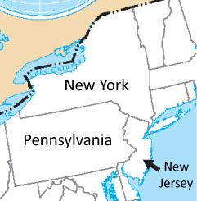
Two Colors?
Can we use only two colors?
Let’s zoom in on a portion of the map

Slide 7
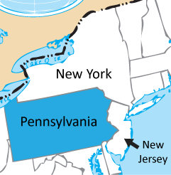
Two Colors?
We need to choose a color for Pennsylvania, say blue

Slide 8
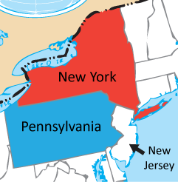
Two Colors?
Since New York borders PA, we can’t use blue for NY, so we need a second color, say red

Slide 9
Two Colors?
But now New Jersey borders a blue state and a red state, so it can’t be red or blue
We need a third color

Slide 10
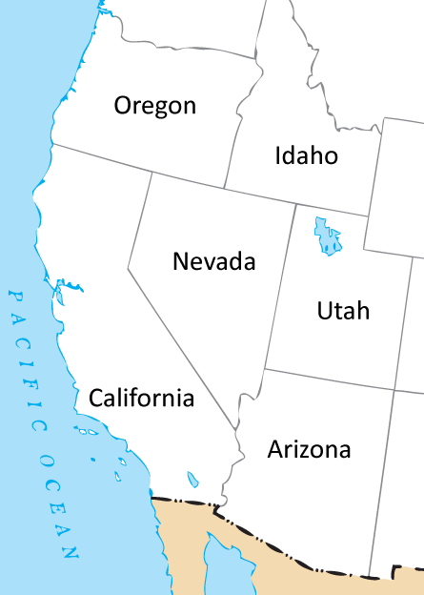
Three Colors?
Are three colors enough?
Let’s look at another part of our US map

Slide 11
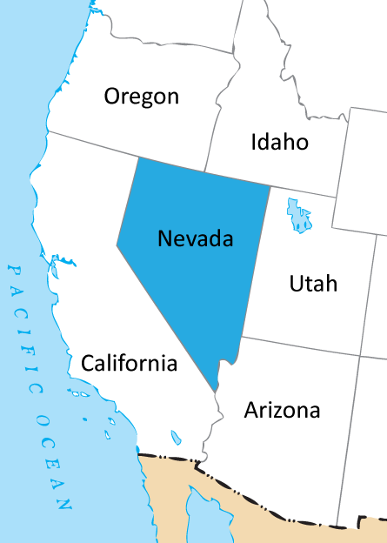
Three Colors?
Let’s start by coloring Nevada blue
Now none of the states that border Nevada can be blue

Slide 12
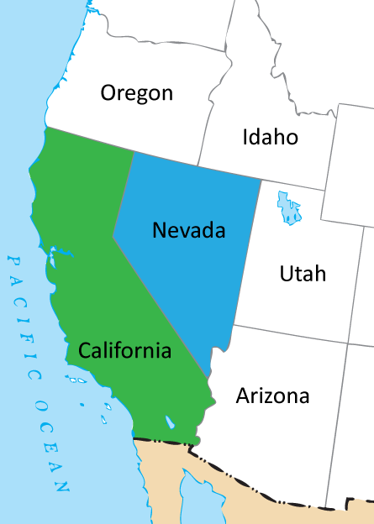
Three Colors?
So California needs to be a different color, let’s say green

Slide 13
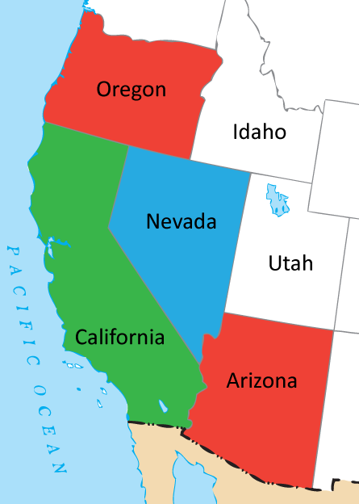
Three Colors?
Since Oregon and Arizona both border Nevada and California, these states cannot be blue or green
But since they don’t border each other, they can be the same color, let’s say red

Slide 14
Three Colors?
What about Idaho and Utah?
Neither state can be blue or red
One of them could be green, but since they border each other, they can’t both be green
We need a 4th color!

Slide 15
Four Colors!?
It turns out four colors are enough to color the entire map properly
In fact, for any possible map, four colors will always be enough
Finding a proper coloring that uses the minimum number of colors can be very difficult

Slide 16
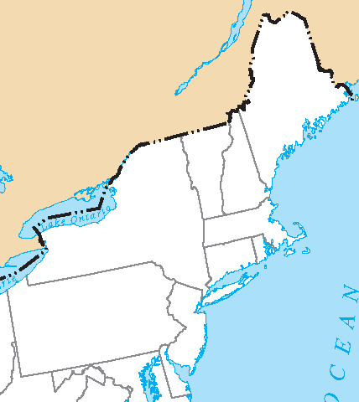
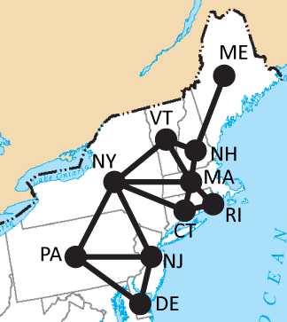
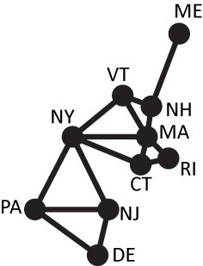
Using Graphs to Color
We can use graphs to model the coloring problem

Slide 17
Using Graphs to Color
Each vertex represents a state (or region on the map we want to color)
We connect two vertices with an edge if the two regions share a border

Slide 18
Using Graphs to Color
We want to color the vertices so that if two vertices have an edge between them, they are different colors

Slide 19
A “Greedy” Algorithm
With a greedy algorithm, we choose some order in which to solve our problem
At each step, we make the best choice we can at the time
We don’t go back and change our minds

Slide 20
A “Greedy” Algorithm
In this case, we’ll put the vertices in alphabetical order
We have some colors we want to use, let’s say:
Color #1 is blue
Color #2 is green
Color #3 is red
Color #4 is orange

Slide 21
A “Greedy” Algorithm
In order, we color each vertex with the lowest numbered color we can, following the coloring rules
We only use a new color if we have to

Slide 22
Using the Greedy Algorithm
Let’s start
The first vertex is CT

Slide 23
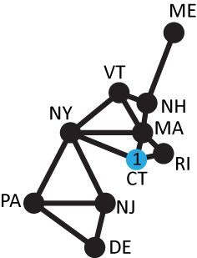
Using the Greedy Algorithm
Let’s start
The first vertex is CT
We color it using our first color, blue
If you don’t have colored pens, just label the vertex with the color number (1)

Slide 24
Using the Greedy Algorithm
Next is DE

Slide 25
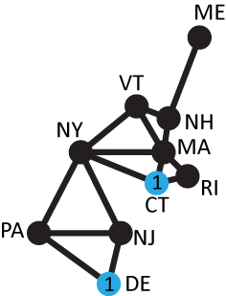
Using the Greedy Algorithm
Next is DE
Since DE doesn’t border any vertices we have colored yet, it can be blue also

Slide 26
Using the Greedy Algorithm
Next is ME (Maine)

Slide 27
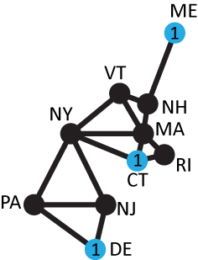
Using the Greedy Algorithm
Next is ME (Maine), which can also be colored blue

Slide 28
Using the Greedy Algorithm
Next is MA (Massachusetts)

Slide 29
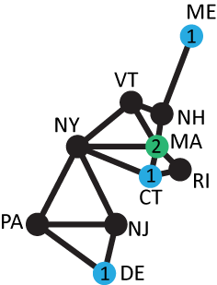
Using the Greedy Algorithm
Next is MA (Massachusetts)
Since MA is connected by an edge to a blue vertex, it can’t be blue
So we have use our #2 color, green

Slide 30
Using the Greedy Algorithm
Next is NH

Slide 31
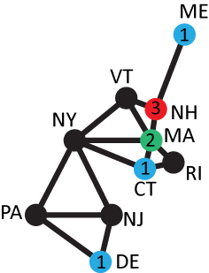
Using the Greedy Algorithm
Next is NH
NH borders blue and green states
So we have to use color #3: red

Slide 32
Using the Greedy Algorithm
Up next is NJ

Slide 33
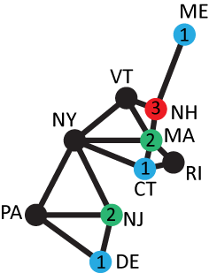
Using the Greedy Algorithm
Up next is NJ
NJ borders a blue state, so we use color #2: green
We could use color #3, but according to the algorithm, we use the lowest numbered color we can

Slide 34
Using the Greedy Algorithm
Next is NY

Slide 35
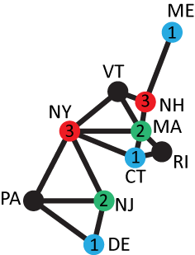
Using the Greedy Algorithm
Next is NY
NY borders blue and green states, but no red states
So we can use red for NY

Slide 36
Using the Greedy Algorithm
Next up is Pennsylvania

Slide 37
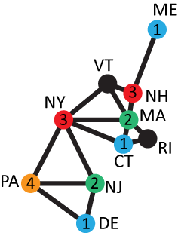
Using the Greedy Algorithm
Next up is Pennsylvania
Since PA is connected to vertices colored with colors 1, 2, and 3, we must use color #4

Slide 38
Using the Greedy Algorithm
Next is Rhode Island

Slide 39
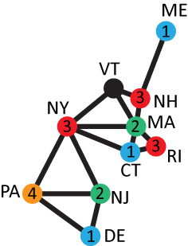
Using the Greedy Algorithm
Next is Rhode Island
RI borders colors 1 and 2, so we use color #3

Slide 40
Using the Greedy Algorithm
Finally we have Vermont

Slide 41
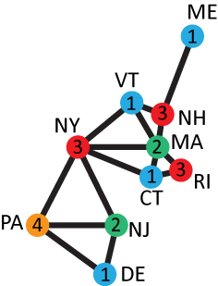
Using the Greedy Algorithm
Finally we have Vermont
Vermont only borders colors 2 and 3, so we can use color #1
We have finished our coloring with 4 colors

Slide 42
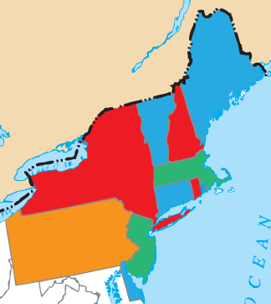
Using the Greedy Algorithm
This graph coloring gives us a map coloring, and we could use this method for the whole US map

Slide 43
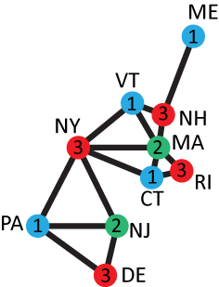
Not the Best Answer
The greedy algorithm is easy to use, but it doesn’t always give the best answer

Slide 44
The Greedy Coloring Algorithm
Choose an order for the vertices.
Choose a list of colors, also in some order.
In order, color each vertex using the first legal color on the list, making sure that no two adjacent vertices are the same color.
Continue in this way until each vertex is colored.

Slide 45
Application: Scheduling
Suppose you are in charge of assigning rooms for a small convention
There are several events occurring, and each event needs its own room
We can use the same room for two different events as long as the times do not overlap

Slide 46
Application: Scheduling
For example, suppose we have 10 events
How many rooms do we need?
A. 3:30pm – 4:30pm | F. 3pm – 4pm
B. 1pm – 3pm | G. 4:30pm – 6:30pm
C. 5pm – 7pm | H. 7:30pm – 9pm
D. 4:30pm – 5pm | I. 2pm – 6pm
E. 1:30pm – 2:30pm | J. 5pm – 8pm

Slide 47
Application: Scheduling
For example, suppose we have 10 events
We can draw a graph to represent this problem: each vertex represents an event, and two events are connected if they overlap
A. 3:30pm – 4:30pm | F. 3pm – 4pm
B. 1pm – 3pm | G. 4:30pm – 6:30pm
C. 5pm – 7pm | H. 7:30pm – 9pm
D. 4:30pm – 5pm | I. 2pm – 6pm
E. 1:30pm – 2:30pm | J. 5pm – 8pm

Slide 48
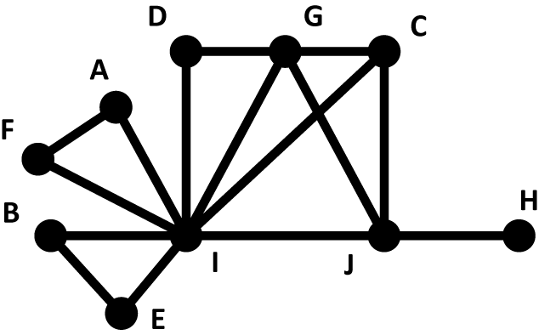
Application: Scheduling
Our graph might look something like this
A. 3:30pm – 4:30pm | F. 3pm – 4pm
B. 1pm – 3pm | G. 4:30pm – 6:30pm
C. 5pm – 7pm | H. 7:30pm – 9pm
D. 4:30pm – 5pm | I. 2pm – 6pm
E. 1:30pm – 2:30pm | J. 5pm – 8pm

Slide 49
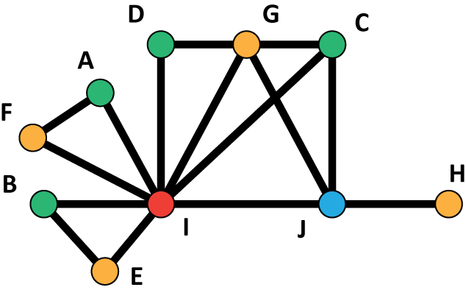
Application: Scheduling
If we properly color the graph, then each color represents a room
A. 3:30pm – 4:30pm | F. 3pm – 4pm
B. 1pm – 3pm | G. 4:30pm – 6:30pm
C. 5pm – 7pm | H. 7:30pm – 9pm
D. 4:30pm – 5pm | I. 2pm – 6pm
E. 1:30pm – 2:30pm | J. 5pm – 8pm

Slide 50
Application: Bandwidth Allocation
As another application, consider how broadcast signals work
The signals sent by radio and TV towers use different frequencies
When you change the frequency on your radio, you change which station you are listening to

Slide 51
Application: Bandwidth Allocation
If you drive your car in a particular direction, eventually you will get too far from the broadcast tower for the station you are listening to, and the station will fade out
However, you may eventually get closer to another tower using the same frequency, and you will pick up a different station

Slide 52
Application: Bandwidth Allocation
Different stations are allowed to use the same frequency as long as they are far enough apart
Cell phone broadcast towers use the same principle

Slide 53
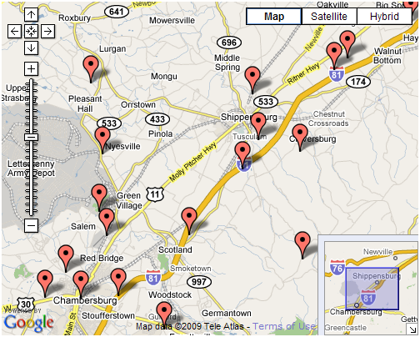
Application: Bandwidth Allocation
This map shows the location of the cell phone broadcast towers in the Shippensburg area
There is a radius around each tower that represents its broadcast area

Slide 54
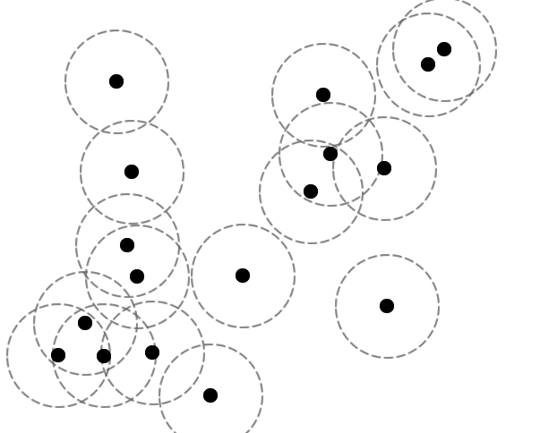
Application: Bandwidth Allocation
We will use a graph to represent this problem
Each tower will be represented by a vertex
Two towers are connected if their areas overlap

Slide 55
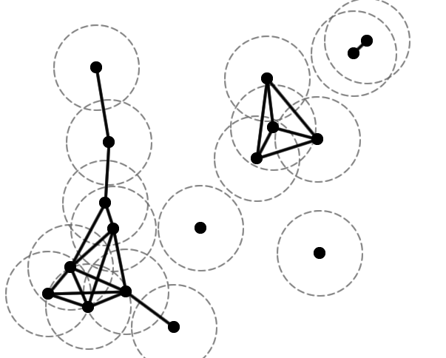
Application: Bandwidth Allocation
Our graph looks something like this
When we properly color this graph, we will be making sure that two towers that are too close to each other get different colors

Slide 56
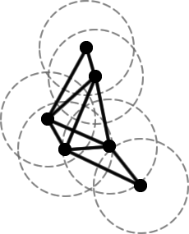
Application: Bandwidth Allocation
So each color represents a bandwidth that the tower can use
If we color this graph…

Slide 57
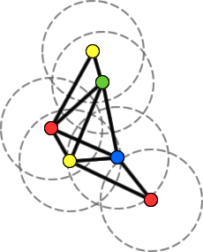
Application: Bandwidth Allocation
So each color represents a bandwidth that the tower can use
If we color this graph…
… we see that we would need 4 frequencies

Slide 58
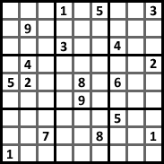
Application: Sudoku
You may have seen Sudoku puzzles before
There is a 9x9 grid, and each square should be filled in with a number from 1 to 9 so that each column, each row, and each 3x3 subsquare contains 1 through 9 exactly once

Slide 59
Application: Sudoku
We can represent this puzzle with a graph
Each of the 81 squares is a vertex
We connect each to the squares that must contain different numbers

Slide 60
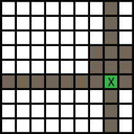
Application: Sudoku
For example, the square labeled X must have a different number than the 20 shaded squares
When we color our graph with 9 colors, we will have solved the puzzle

Slide 61
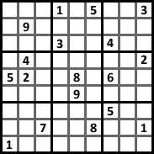
Partial Coloring
A coloring problem that comes from a Sudoku puzzle is an example of a partial coloring
Some of the vertices are already colored
We have to determine how to color the rest

Slide 62
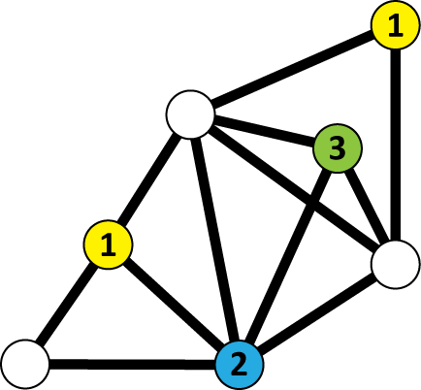
Partial Coloring
For example, this graph is partially colored
We could use the greedy coloring algorithm or some other method to finish the coloring

Slide 63
How Many Colors?
The problem of figuring out how many colors are needed to properly color a map has been studied for hundreds of years
It was long thought that only 4 colors are ever needed
This was finally proved in 1976 with the aid of computers

Slide 64
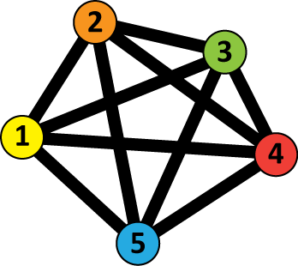
How Many Colors?
We can consider the graph coloring problem for many different types of graphs, not just ones that come from maps
In general, more than 4 colors might be needed if the graph doesn’t come from a two-dimensional map

Slide 65
How Many Colors?
We want to find the chromatic number for a graph, which is the smallest number of colors needed to properly color the vertices of the graph
In general, this can be a very difficult problem, but there are ways to narrow the possibilities

Slide 66
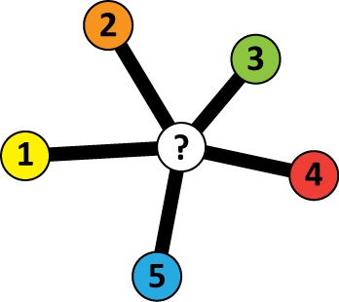
Using the Greedy Algorithm
When we use the greedy algorithm, we only need a new color when we reach a vertex that is adjacent to vertices of all the colors we already have
In the worst case, the vertex with the highest degree might be this kind of vertex

Slide 67
Using the Greedy Algorithm
In this example, our vertex has degree 5, and would force us to use a 6th color
But this is the worst case
So that tells us that our chromatic number can be at most equal to 1 + the highest degree in the graph

Slide 68
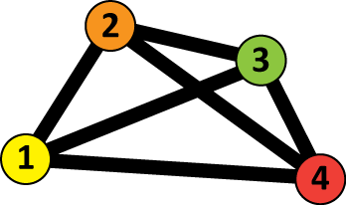
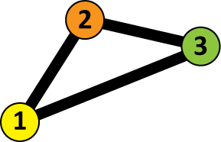
Using Cliques
A clique in a graph is a collection of vertices that are all mutually adjacent to each other
A clique is a complete graph inside of the larger graph

Slide 69
Using Cliques
A clique in a graph is a collection of vertices that are all mutually adjacent to each other
Each vertex in a clique must be given a different color

Slide 70
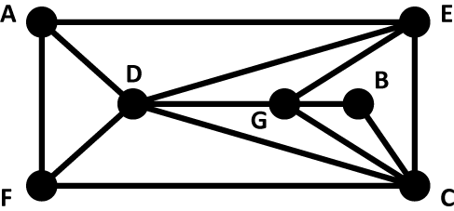
Using Cliques
If we look for the biggest clique in a graph, that tells us we need at least that many colors
What is the biggest clique in this graph?

Slide 71
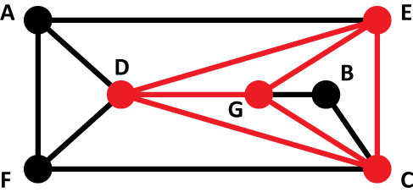
Using Cliques
The biggest clique in this graph has 4 vertices
That tells us that we will need at least 4 colors to properly color this graph

Slide 72
Upper and Lower Bounds
The two principles we have just discussed give us upper and lower bounds on the chromatic number
However, finding the exact chromatic number can still be quite difficult
Size of the largest clique
Chromatic number
1 + highest degree in the graph
≤
≤

